Slide 1



MindXpress Quiz App Presentation
Internet and Web Programming
BCSE404L (Prof. PN Renjith)
Submitted By: Win Verma 21BLC1219

Slide 2
Frontend Design Using HTML5 and CSS3
Content:
Brief overview of MindXpress, its purpose, and the technologies used (HTML, CSS, JavaScript).
Mention the future integration of backend and custom quiz functionality.
Emphasize the elegant and calming color palette.
The project showcases a simple, yet elegant user interface with a calming color palette.
Future work includes backend integration and the implementation of custom quiz functionality, enhancing the interactivity and personalization of the app.

Slide 3
Introduction
The MindXpress project is a web-based application developed as part of the BCSE404L Internet and Web Programming course. This project serves as a practical application of web development concepts, focusing on the creation of an interactive and responsive quiz application.
Significance of MindXpress
MindXpress aims to provide an engaging and user-friendly platform where users can test their knowledge on various topics through a series of well-crafted questions. The project is designed with a calming and elegant color palette to enhance the user experience, ensuring that the application is both visually appealing and functional.
Main Objectives
Interactivity: Implement a dynamic quiz interface where users can select answers, receive instant feedback, and track their scores.
Responsiveness: Ensure that the quiz app is fully responsive, providing an optimal user experience across different devices, including desktops, tablets, and mobile phones.
User Engagement: Create a visually appealing design using HTML, CSS, and JavaScript to keep users engaged and make the learning process enjoyable.
Future Development: Lay the groundwork for future integration with backend functionalities, allowing for custom quiz creation and data storage.
This project not only demonstrates the technical skills acquired during the course but also highlights the importance of user experience and responsive design in modern web applications.

Slide 4
Existing Systems
Static Content:
Many traditional quiz applications offer static questions with limited interactivity.
User experience is often hindered by outdated designs and a lack of responsiveness.
Limited Customization:
Most quiz platforms do not allow users to create or modify quizzes.
Customization options are often locked behind premium services or complex interfaces.
User Engagement:
Existing systems may not prioritize user engagement, leading to a lack of motivation for repeated use.
The aesthetic and interactive elements are often neglected, making the experience mundane.
Device Compatibility:
Many quiz apps are not optimized for mobile devices, resulting in poor user experience on smaller screens.
Responsive design is often overlooked, leading to issues with accessibility and usability.

Slide 5
Methodology
1. Development Approach
Frontend Development:
Utilized HTML for structuring content and creating a semantic layout.
Designed an engaging and responsive UI with CSS, focusing on an elegant, calming color palette.
Implemented dynamic behavior and interactivity using JavaScript, enabling functionalities like question navigation, answer selection, and score tracking.
Responsive Design:
Ensured that the application adapts seamlessly to various screen sizes using CSS media queries.
Employed flexible layouts and fluid grids for optimal viewing on both mobile and desktop devices along with cool animations and hover effects.

Slide 6
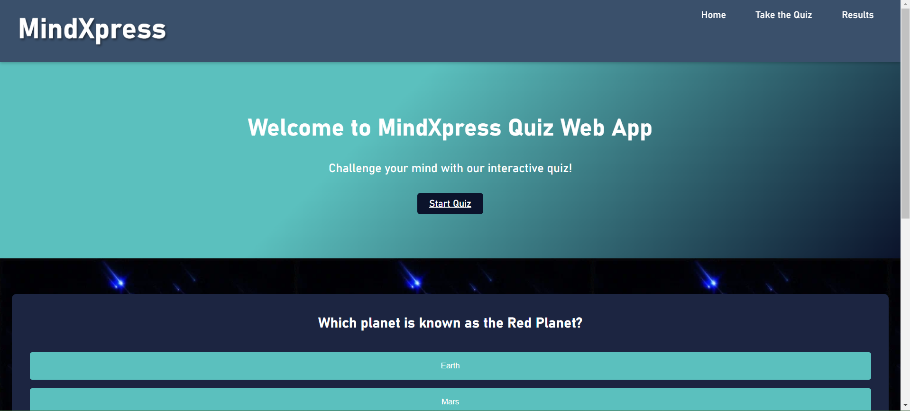
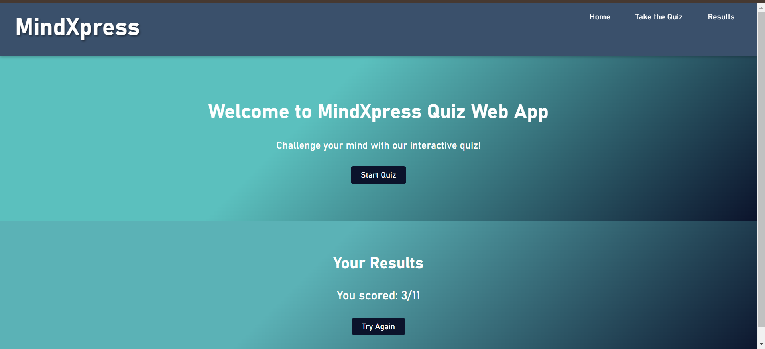
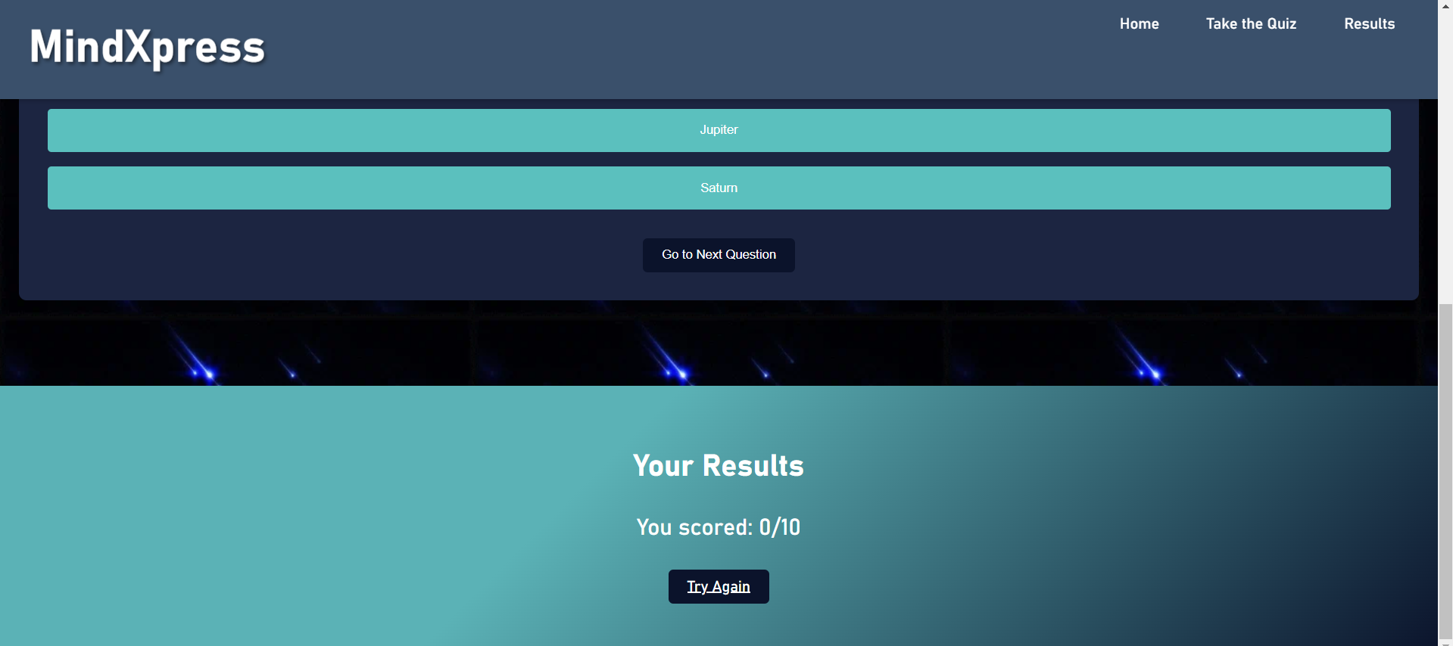
Screenshots

Slide 7
Deployment and Future Work
Deployment:
Objective: Make the application available to users.
Hosting: Deploy the frontend application to a web hosting service such as Netlify.
Version Control: Use GitHub for version control and code management.
GitHub CI/CD:
Set up continuous integration and deployment pipelines to automatically test and deploy the application.
Objective: Ensure that the application functions as expected and is free of bugs.
Unit Testing: Test individual components and functions to verify correctness.
Integration Testing: Check the interaction between different components of the application.
User Testing: Conduct usability testing with real users to gather feedback and make improvements.
Future Work
Objective: Plan for future enhancements and integrations.
Backend Integration: Implement server-side functionality for managing user data and saving quiz results.
Custom Quiz Features: Develop advanced quiz features such as personalized questions and adaptive difficulty levels.
Link: https://66bd46d2d7864527e53e8a77--mind-nasturtium.netlify.app/

Slide 8

Part – II (Backend with PHP and MYSQL)
WHAT WE DID NEXT FOR Script.js:
Clear Previous States:
The showQuestion function now resets button states each time a new question is shown.
Single Event Listener for Options:
Instead of adding a new event listener each time a question is displayed, we attach it once during the initial setup for each button. This ensures the correct button actions are applied.
Correctly Accessing option_correct:
The selectAnswer function now checks the selected button against the correct answer using the current question's option_correct.

Slide 9

Folder Structure in htdocs
Project Structure:
Set up SQL based Queries to fill up the database with Questions and their attributes.
Folder Structure:
index.html: Main HTML file.
styles.css: Styles for the app.
script.js: JavaScript file for quiz functionality.
db.php: Database connection script.
get_questions.php: Fetching questions from the database.

Slide 10

Database Setup with Xampp’s MYSQL
Explanation of get_questions.php
Fetching questions from the database and returning them in JSON format.
Importance of JSON format for JavaScript integration.
script.js:
fetchQuestions(): Fetches questions from the server.
showQuestion(): Displays the current question and options.
selectAnswer(): Handles user input and updates score.
showResults(): Displays final score after quiz completion.

Slide 11

Challenges and Solutions
Database Connection Issues
Difficulty in connecting to the database initially.
Resolved by checking database credentials and configuration.
JavaScript Errors
Encountered errors while attaching event listeners.
Fixed by ensuring script execution after DOM elements were loaded.
Answer Selection Problems
Users were unable to select answers properly.
Adjusted the logic to ensure correct answers were recognized.

Slide 12
Future Work and Conclusion for Part - II
Conclusion:
Successfully developed an interactive quiz application.
Users can answer questions and receive instant feedback.
Future Enhancements:
Quiz Review Feature:
Allow users to review their answers after completing the quiz, highlighting correct and incorrect responses.
Randomized Question Order:
Shuffle questions each time the quiz starts to provide a unique experience for users.
Progress Indicator:
Implement a progress bar or step indicator to show users how many questions they have completed.
Multiple Attempts:
Enable users to retake the quiz and track their best scores.
Hints or Lifelines:
Provide hints for each question that users can use to assist them in selecting the correct answer.

Slide 13
Thank You!
I learnt a lot from this project and now we got a whole new idea to create a full stack web application using technologies like Angular or React for different components of the web page which we have planned to integrate along with Database Connectivity like MongoDB/Web Hosted Categorical Quizzes. We’ll use better visual design and even better animations and interactive elements to make this project ready for public deployment.
I would like express our gratitude for providing us an opportunity to work on our HTML/CSS and JavaScript skills.

